Slide 1

「 the Parallel Forest 」
Group 1 : YOYO Team
NI WEIHAO 倪玮昊
LIU ZHUOER 刘卓尔
XUE TINGYUN 薛婷匀
WANG YUYANG 王宇洋

Slide 2
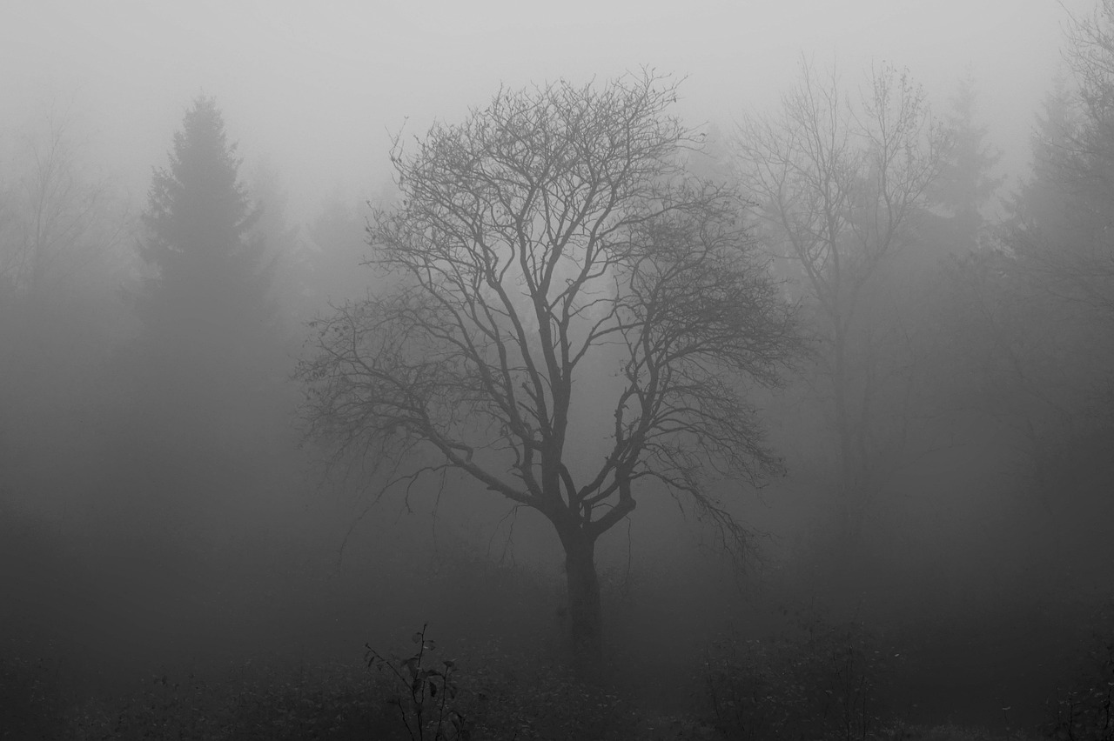
| Contents
Game Idea
Game Mechanic
Game Details
Game Feasibility and Challenges

Slide 3
A. Game Idea - background
A man wakes up from the depths of the jungle to find himself in a predicament, but he can switch between two parallel worlds to help him complete his adventurous escape in the original world through the perspective of the other world. However, after completing several organ adventures with the help of this special feature, he finds himself permanently trapped in the parallel world when he switches to it for the last time.........

Slide 4
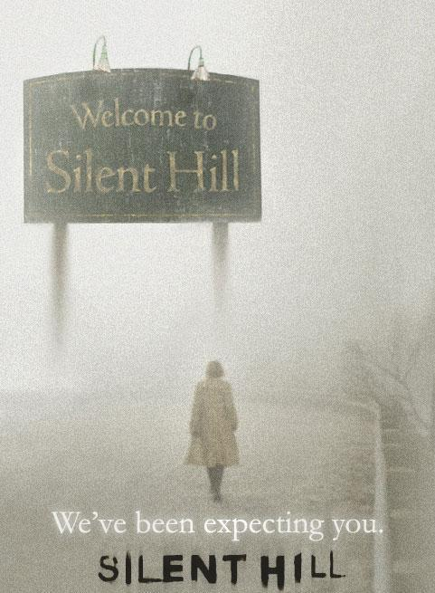
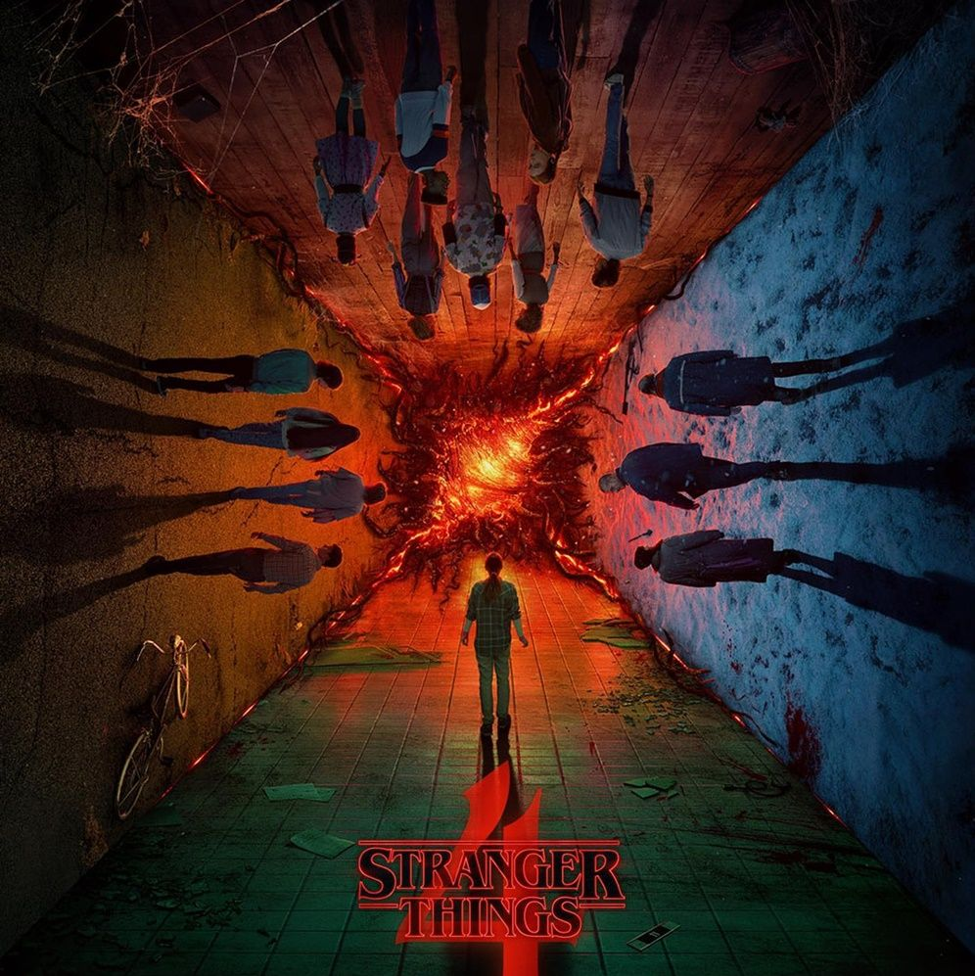
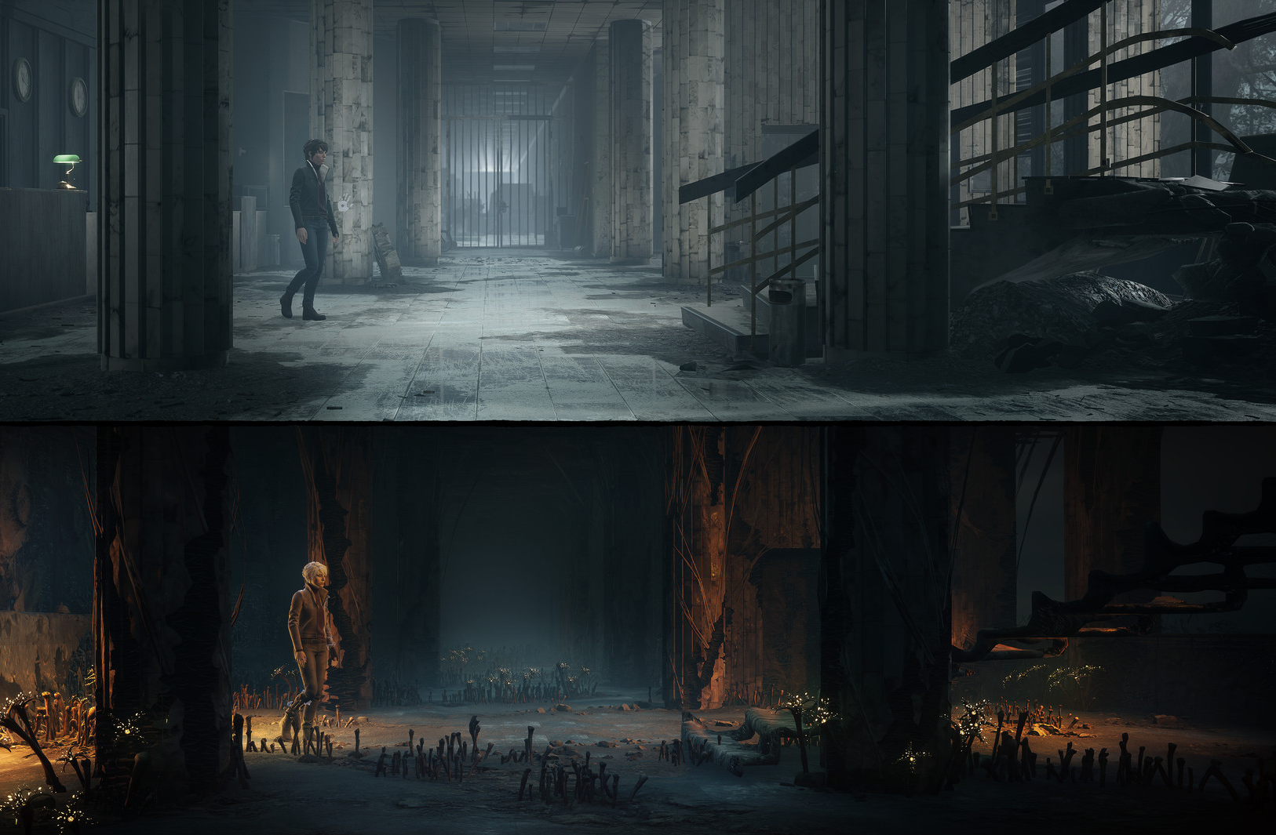
A. Game Idea - form..

Slide 5
A. Game Idea - introduction
Game name : <the Parallel Forest>
Typology : 2D Horizontal Jumping Game
Platforms : PC

Slide 6
B. Game Mechanic - logic
Based on the story line mechanism
Game is designed with three levels
Players need to fight with the enemies in each level. If the player beat the big boss and still survives, they can enter the next level. If the player died, they need to restart the level.
Players who have completed all the levels will complete the story line and understand the ending of the story.

Slide 7
B. Game Mechanic - genre
Adventure
Thriller
Suspense

Slide 8
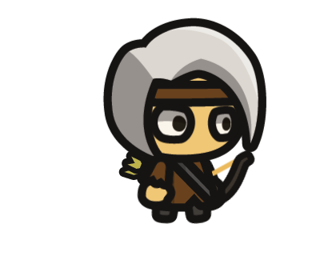
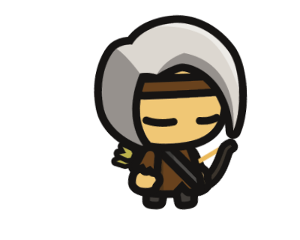
C. Game Details - player
Motion Control:
Key W/S to control vertical jump and crouch
Key A/D to control horizontal movement
Behavioral Control:
The hero has a sword that can be used for close-range attacks and a bow for long-range attacks (long-rangeattacks must have ammo)，Key J for close-range attacks and key K for long-range attacks.
The player switches to an otherworldly viewpoint with key L , in the other world the player moves slower and cannot attack.

Slide 9
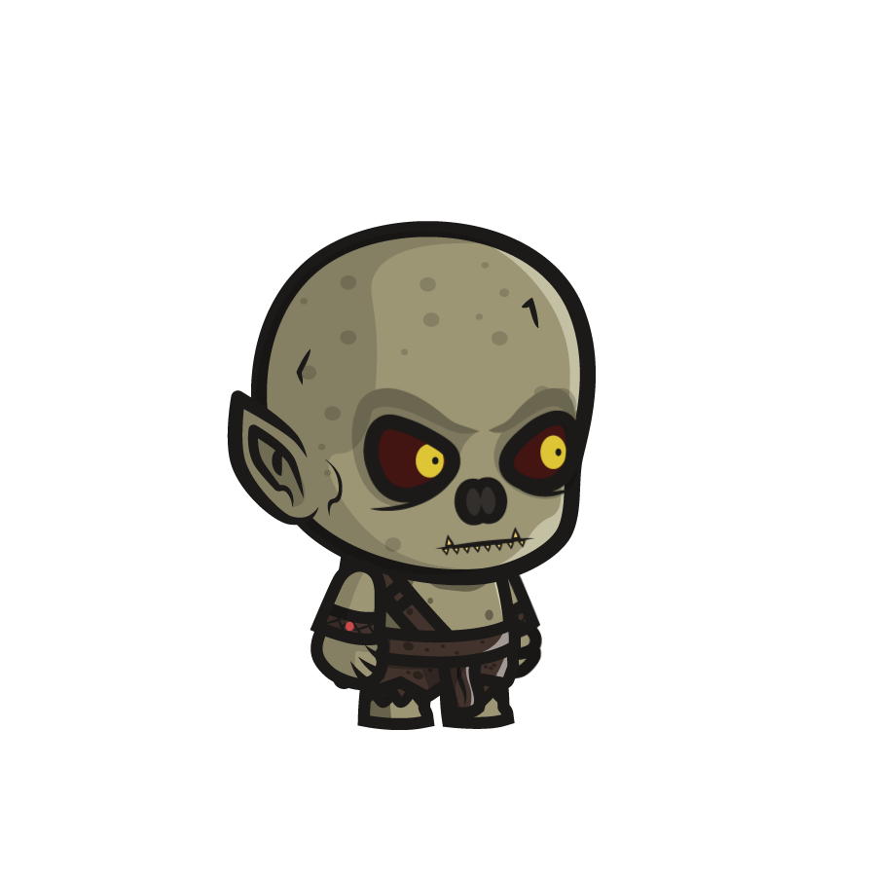
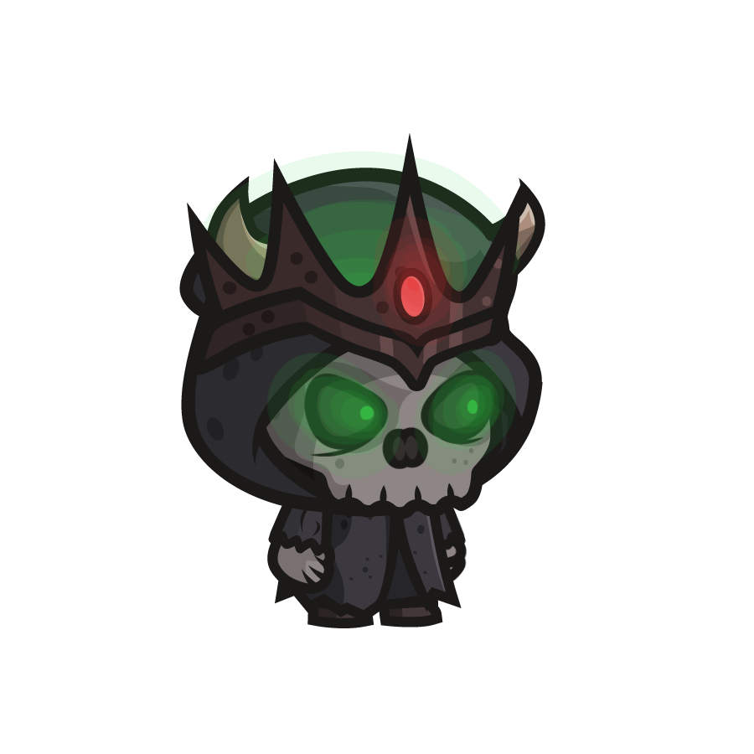
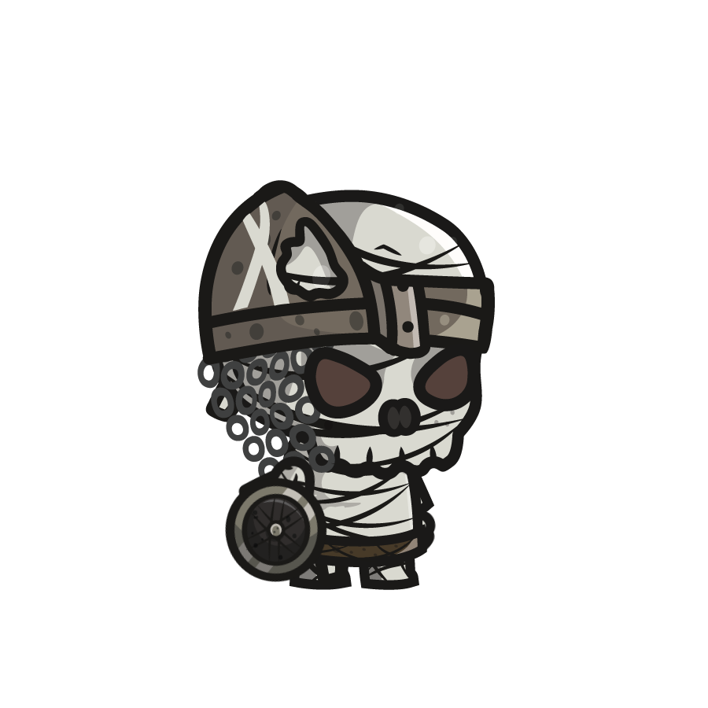
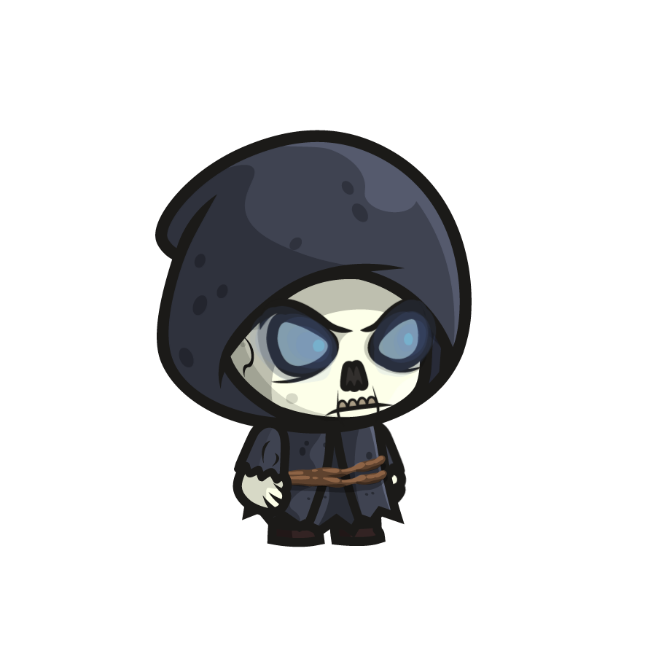
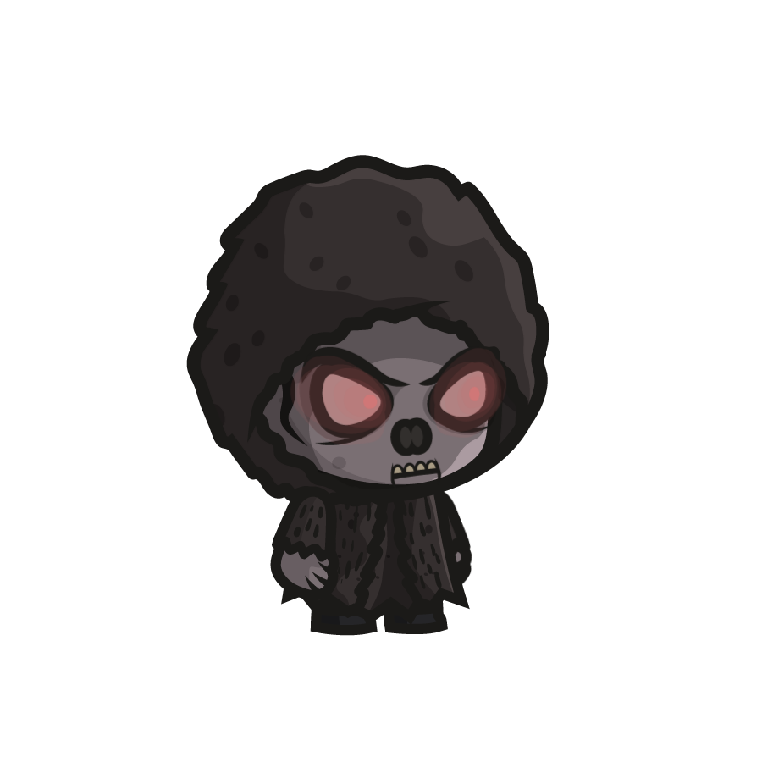
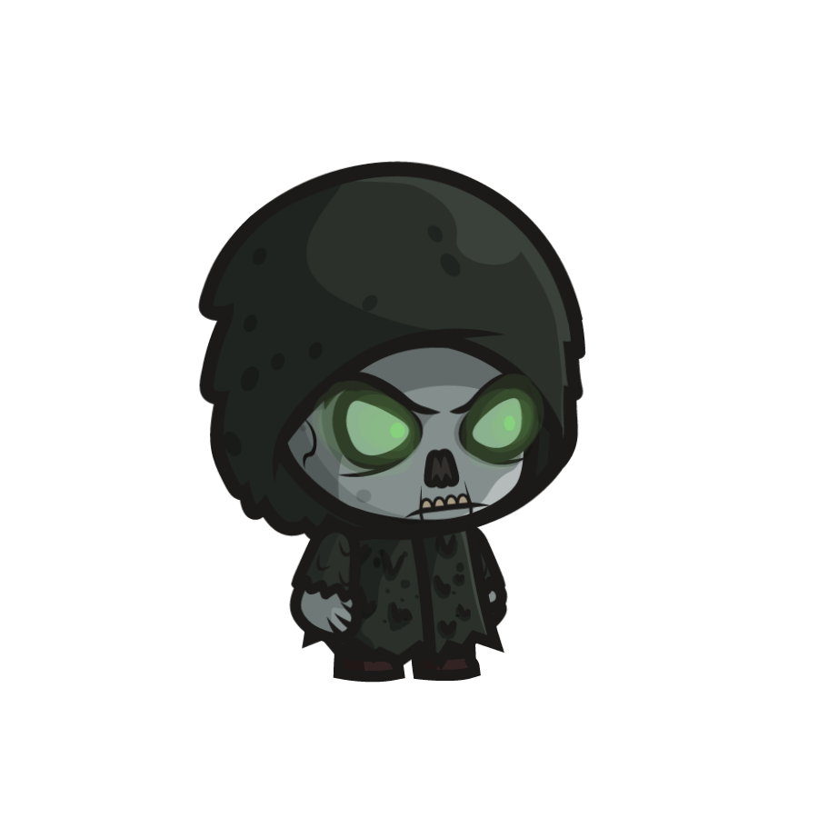
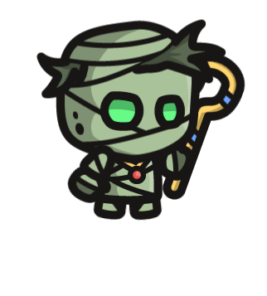
C. Game Details - enemy
Enemy 1
Exists in both the original world and the parallel world.
Initial generation moves horizontally in a random direction, and when the player enters the detection range ,it will accelerate towards the player.
Enemy 2
They can only be seen in the parallel world.
Enemies will be more aware of players in parallel worlds.
Big Boss
They will appear at the end of each level
with both of the first two movement characteristics and when the player have a collision with them, the player will loss more blood than usual.

Slide 10
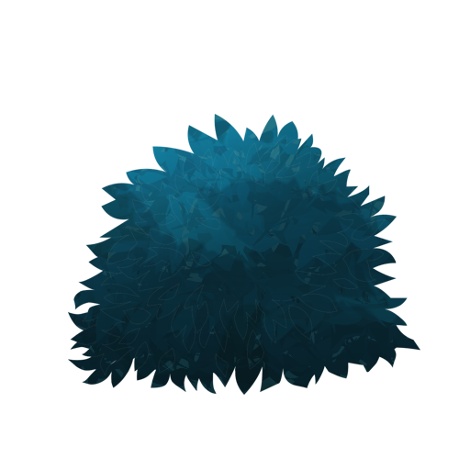
C. Game Details - blocks
As an element of level design, the player needs to jump onto obstacle blocks.

Slide 11
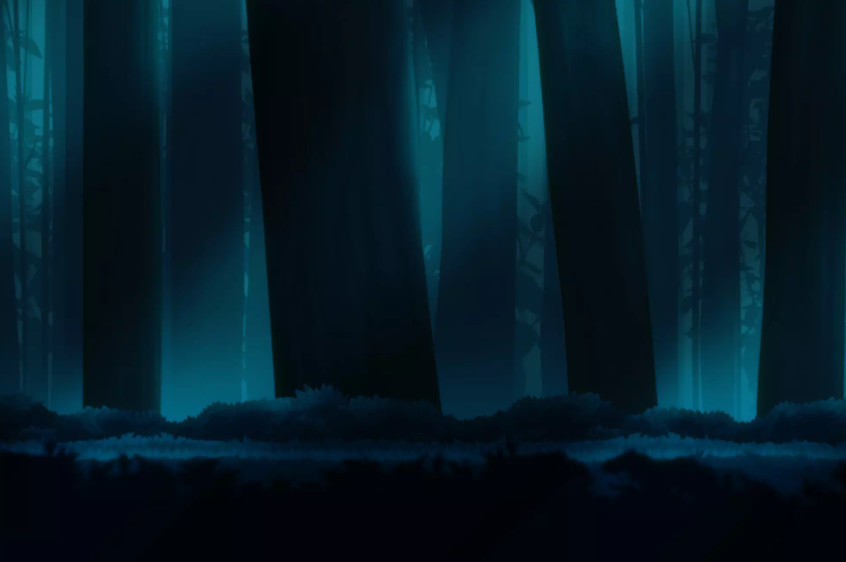
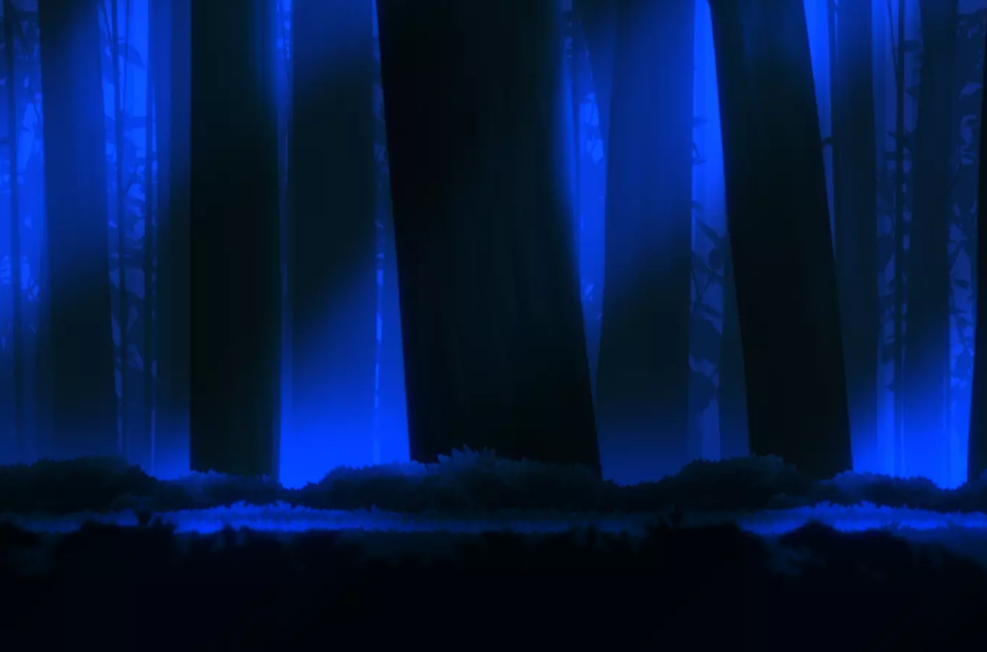
C. Game Details - Scene rendering
Original World
Relatively bright rendering
Natural forest sound effects
Parallel World
Relatively shadowy rendering
Scary sound effects

Slide 12
C. Game Details - UI
it will show:
Player Blood Bar
Player Bullet Volume
Story guide for the beginning and end of the game

Slide 13
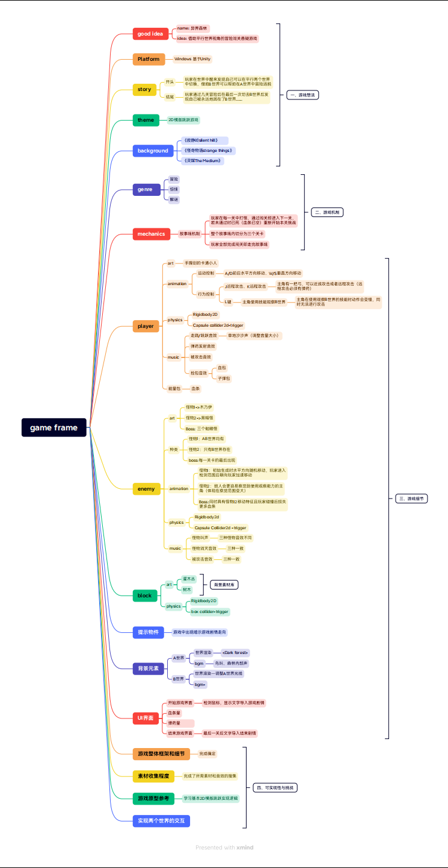
D. Game Feasibility and Challenges
we already checked these:
The overall framework of the final game and the game contains all the details
Collection of all game materials and sound effects
Guidance material for the prototype of a 2D horizontal board jumping game
we think the biggest challenge is:
❏Realize the interaction between the two worlds

Slide 14
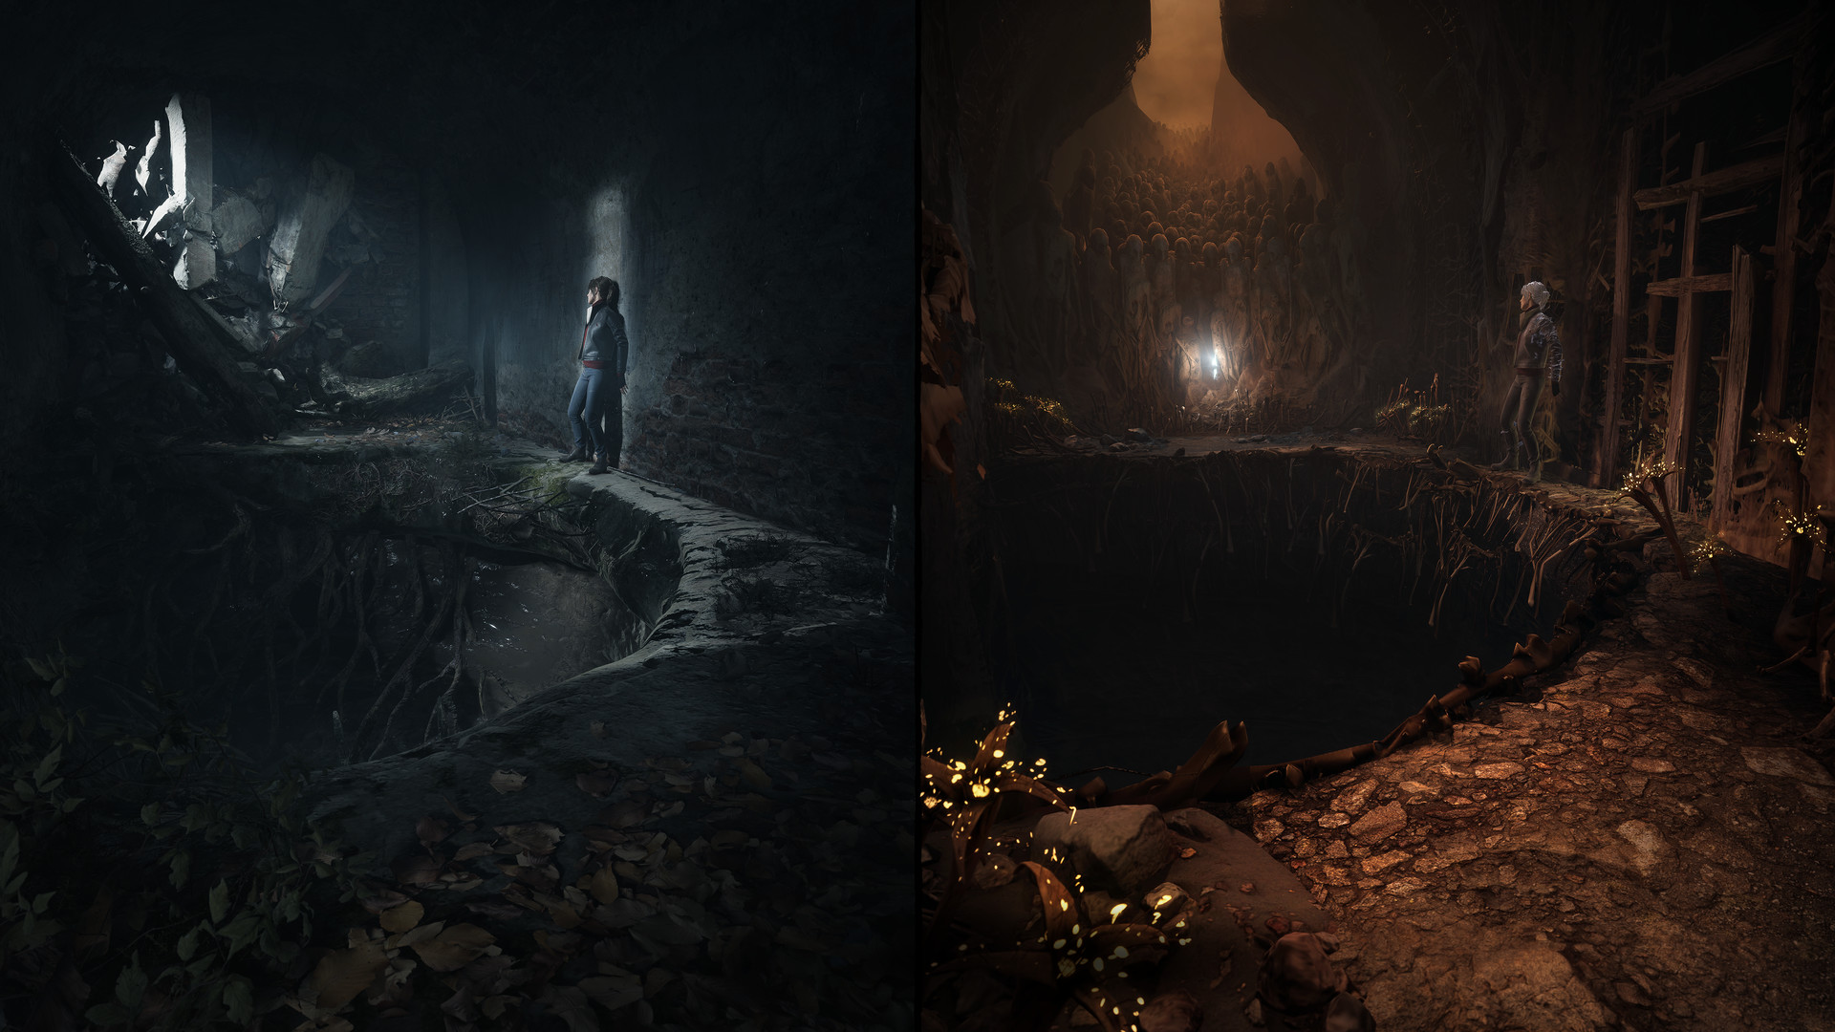
Let's look forward to 「the Parallel Forest」
together!
Thanks for listening

